Slide 1
Educator accountability for learner performance; It is a fair practise in the teaching and learning of French in Botswana?
Presented by Ms Tshepo Sharon Leepile Baipusi
Mothamo Junior School,
THE 13th SAAEA CONFERENCE
19th to 22nd May 2019, GABORONE, BOTSWANA

Slide 2
Outline
Why education?
Why assessment in education?
The French language in Botswana’s curriculum
Accountability for results
Conlusion

Slide 3
Purpose of education
Produce well rounded citizens
Promote a variety of learning styles
-BEC Assessment Syllabus
Produce accountable learners

Slide 4
Why assessment in education
Mandate of the Botswana examination Council
Gauge skills acquisition
A -show good understanding of phrases and vocabulary related to areas of most immediate personal experience
C - show a fair level of understanding of simple texts that are heard or read;
D- identify very few familiar words from simple texts that are heard or read, with minimal understanding;
Determine curriculum effectiveness
Stakeholder accountability

Slide 5
French Language in Botswana’s curriculum
Introduced in 1999 as a pilot and the first examination 2001
Results have been constantly unpleasing
Top schools scoring no more than 50 and 75% quality and quantity passes (2013-2017)

Slide 6
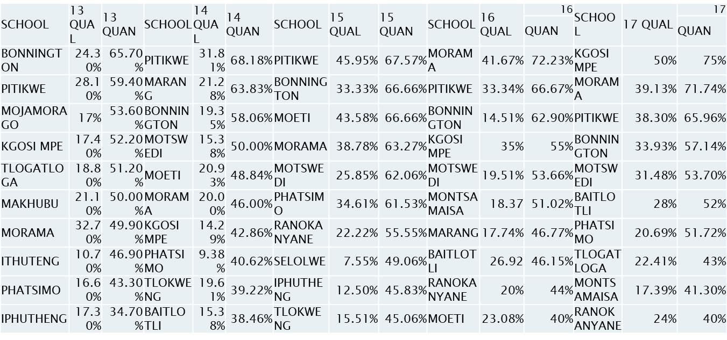
JCE RESULTS 2013-2017 TOP 10

Slide 7
Educator accountability VS Learner performance
What is accountability
the fact of being responsible for what you do and to give a satisfactory reason for it”
’Payment by Results” Frymier, 1998
Place and value of professionalism (Bullough, Clark & Patterson, 2003)

Slide 8
Accounting for results in Botswana Schools
Why these results
Sombre atmosphere triggering defence mode

Slide 9
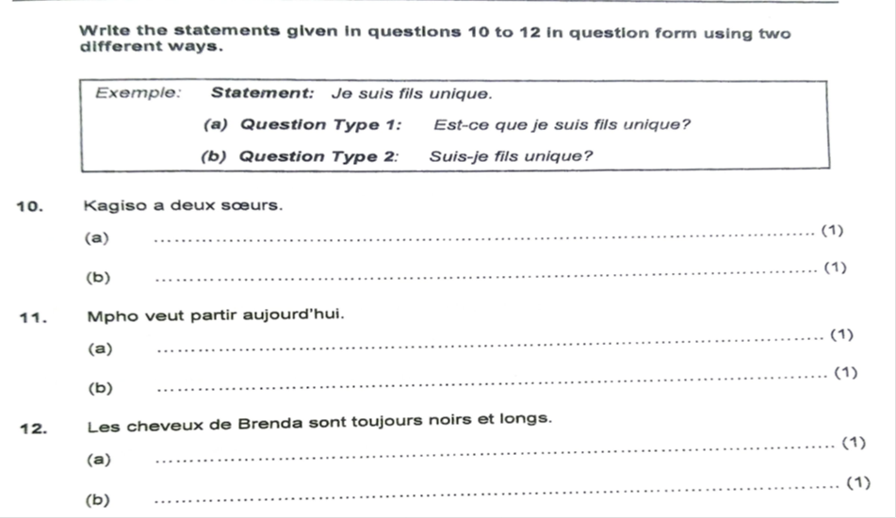
Assessment of JC French
The structure of the components similar
Items also similar year in year out
Oral component not yet tested
Abstract items

Slide 10
Assessment cont…
development of an externalised locus of control rather than an internalised one
Educators will be driven to control their learners’ responses in order to get good results.
Train learners to give ‘BEC answers’

Slide 11
In conclusion
educators must be held accountable for their learners' learning to an extent
Examination results should not be the only variable considered
Factors that affect learner performance which the educator has no control over
e.g. family background
culture
BEC model its testing on the CEFR

Slide 12
Merҫi Beaucoup

